Slide 1
Mineral trioxide aggregate
Halli Melton & Carleigh Watson
Wallace State Dental Hygiene
Class of 2014

Slide 2
introduction
Mineral Trioxide Aggregate
1993
Literature introduction
1998
U.S. FDA approval
Notes:
MTA has been approved by the U.S. Food and Drug Administration in the year 1998. MTA promises to be one of the most versatile materials of this century in the field of dentistry. Some of the appreciable properties of MTA include its good physical properties and its ability to stimulate tissue regeneration as well as good pulp response.
2. Literature for Mineral Trioxide Aggregate (MTA) was first introduced in California in 1993. The material was originally formulated to provide the physical properties, setting requirements, and characteristics necessary for an ideal repair and medicament material. Studies on MTA reveal that it not only exhibits good sealing ability, excellent long term prognosis, relative ease of manipulation and good biocompatibility but favors tissue regeneration as well.

Slide 3
Product description
MTA
80 % Portland Cement
20% Bismuth Oxide
Notes:
Mineral Trioxide Aggregate also known as MTA is made from Portland cement and bismuth oxide.
The percentages of the compound are calculated by weight. Bismuth Oxide is a catalyst for oxidation of various organic compounds.
Portland Cement alone is not intended for human use due to its radiolucent property when used in the oral cavity.
The bismuth oxide agent is not only a catalyst for oxidation of various organic compounds, but also helps clinicians determine whether a cavity has been restored.
MTA follows quality assurance guidelines for the FDA and ensures a reliable and consistent mix.

Slide 4
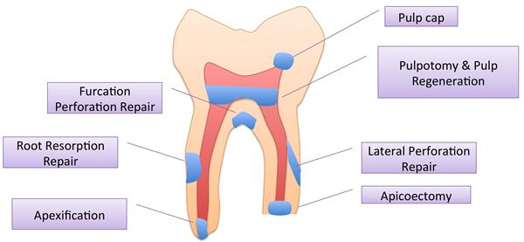
Clinical uses
Notes:
MTA may be used for endodontic infections and inflammation. It also can be used for the procedures listed in the picture.
Mineral trioxide aggregate (MTA) is a biocompatible material which provides a biological seal. MTA has been proposed as a potential medicament for various pulpal procedures like pulp capping with reversible pulpitis, apexification, repair of root perforations, etc.
The fast-setting MTA paste exhibits flow-to-clay-like consistency, which allows new practical applications including cavity lining, temporary restoration, bonding, and cementations in one MTA embodiment. The high calcium hydroxide and high fluoride release are suitable for caries prevention and treatment, and per se inhibition of dental symptoms.

Slide 5
MTA main ADVANTAGES
Excellent marginal sealer
Respectable utilization in the presence of humidity
Induction of dental barrier formation used upon the pulp
Notes:
Although MTA has a great deal of advantages some of its main ones are:
It is an excellent marginal sealer which avoids bacterial migration and tissue fluids penetrating into the root canal.
Varies materials demand that the operatory field be completely dry, which can be difficult, particularly in cases that involve periodontal surgeries so using MTA could prove to be beneficial because It works well in the presence of humidity without losing its properties.
and last but not least another advantage is that MTA creates a direct barrier for the pulp.

Slide 6
Main disadvantage
Cost
Handling properties
Notes:
MTA has great studies to show it as a superior retro fill material but the difficulties with MTA can not be dismissed. The difficulties are firstly related to the cost. It is dispensed in a kit that holds 5 applications per kit. According to manufactures it will run the patient around $100 per application. And, unlike most retro fill materials MTA is meant to be used wet which can make it very difficult to handle.

Slide 7
Supplies for application
Local anesthesia
Rubber dam
Dappen dish
Sterile water
Amalgam carrier or map carrier
Plugger or paper points
Notes:
Mta comes in powder form and they recommend you mix it with sterile water, infact the doctors in the demonstration actually mixed there's with local aesthesis. After mixing the MTA load the mixture into either an amalgam carrier or map carrier. They have recently came out with a MTA carrier that suggest it is easier to use since it is designed specifically for these purposes but it also notes that the amalgam carrier would do. Depending on the location you where placing the MTA you might use a plugger or paper points to push and condense the material In the right spot. Then you could either wet cure it or membrane cure it. Wet curing is when you place a wet cotton pellet above the MTA but it has to be at a perfect ratio because if too wet it can weaken the cement and if too dry it candraw water out of the cement. Membrane curing is where a material is placed above MTA that will not affect the water content of MTA and can be used through the placement of a GIC or RMGIC liner on the MTA that will protect the MTA and enable immediate permanent resotration or obstruction of the tooth.

Slide 8
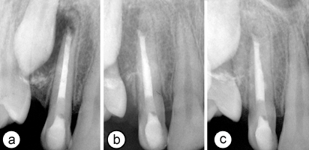
examples
Notes:
Left: (a) Periapical radiograph showing root canal filled with mineral trioxide aggregate. (b) Radiographic view of the tooth at 6 months and (c) 1 year. Note the extent of periradicular healing and the stability of the resorption site.
Right: Fig. 3 – (A) Preoperative radiograph of mandibular second
molar with furcal perforation. (B) Shows WMTA placement.
(C) Post-operative radiograph. Images courtesy of Dr. Brian
Min.

Slide 9
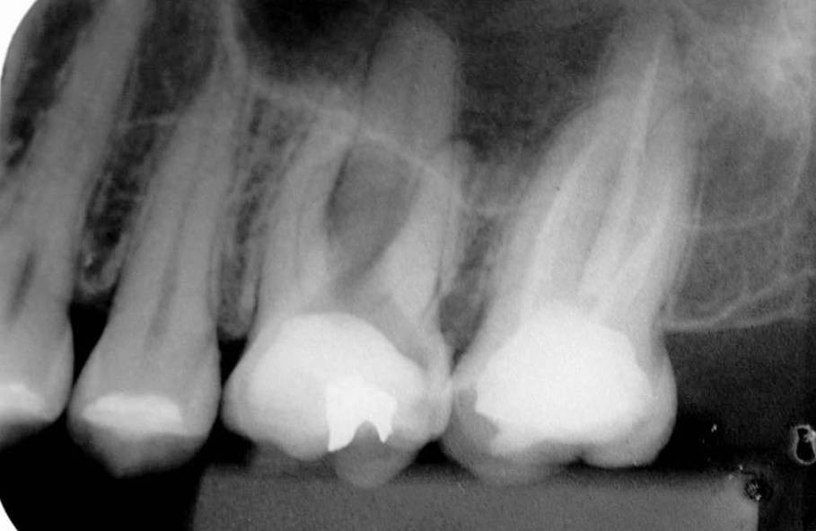
Figure 1
Notes:
A 2 year study of a furcal perforation repair made with MTA listed in the Indian Journal of Dental Research shows: Figure 1: Initial periradicular radiograph of a maxillary left first molar showing a large furcal perforation and apical radiolucencies in the patient in the study

Slide 10
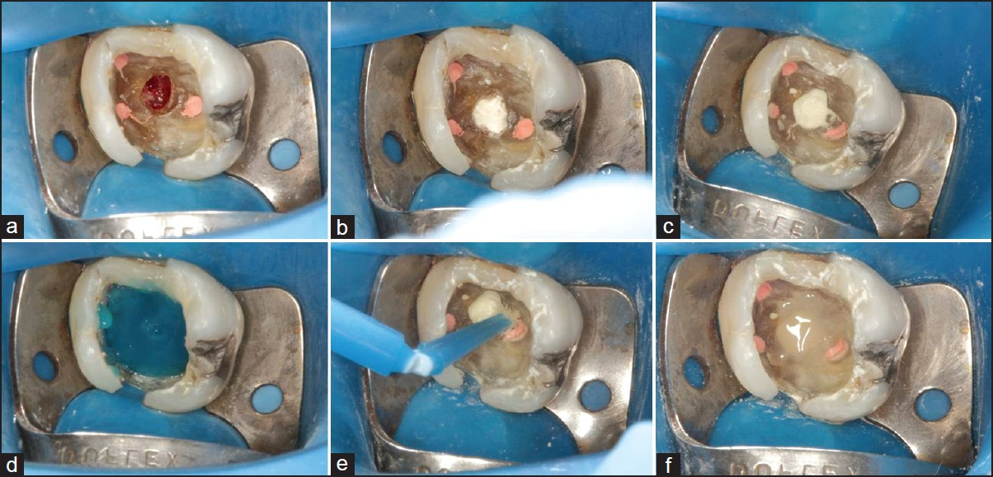
Figure 2
Notes:
Figure 2: (a) Intraoral photograph showing obtured root canal and a large furcal perforation; (b) MTA being placed into the furcal perforation; (c) MTA adapted into the furcal perforation; (d, e and f) Restoration with resin composite

Slide 11
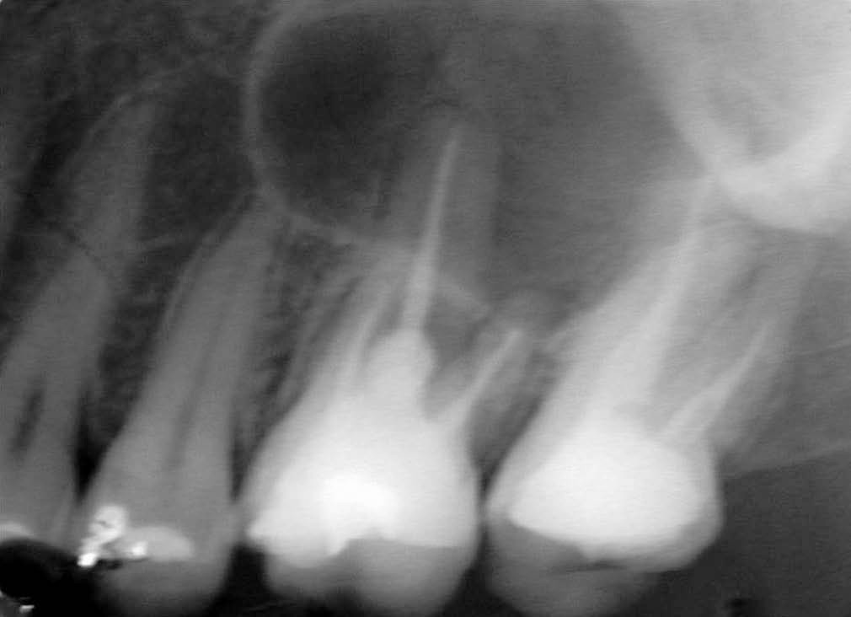
Figure 3
Notes:
Figure 3: Two-year follow up radiograph showing adequate sealing of the perforation region and no radiolucency at the furcal area in the maxillary left first molar of the patient in the study

Slide 12
video
Placement Demo
http://www.youtube.com/watch?v=w8ecADKFkqk&list=PL3P9XO0-Hyy6P81ADQBV2GIlS7QaMote7#t=250
Notes:
First, a paper point is placed into the canal in order to stop the hemorrhage.
Second, take MTA from dappen dish, place in carrier, then into perforation.
Use condenser to make MTA flush against canal walls and pupal floor
Once the MTA is hardened, which is usually 24 hours, a restoration may be placed.
It is important to cover any areas that do not need to be filled because once the MTA has set it causes irritation.
:48 – 1:46

Slide 13
properties
Compressive Strength
Radio-opacity
Solubility
Marginal adaptation & sealing ability
Antibacterial & antifungal property
Reaction with other dental materials
Biocompatibility
Tissue regeneration
Mineralization
Notes:
MTA has a compressive strength equal to an Intermediate Restorative Material such as reinforced zinc oxide eugenol, but less than amalgam.
The radio-opacity of MTA makes it easy to visualize radiographically
Set MTA shows no signs of solubility and is not interfered by an acidic environment
MTA is superior to other traditional root-end filling materials
MTA does not react or interfere with other restorative materials
It does not have toxic or injurous effects on biologic tissues and its function
Mta is capable of activation of cementoblasts and production of cementum
Mta, just like calcium hydroxide, induces dentin bridge formation.

Slide 14
Patent information
Publication number
US20120156308 A1
Publication date
June 21, 2012
Notes:
1. Listed is the US publication number and date found on Google patents

Slide 15
References
http://www.mineraltrioxideaggregate.com
http://endoexperience.com/documents/MTAReview-HowardRoberts.pdf
http://www.google.com/patents/US20120156308
http://www.researchgate.net/publication/40428136_Mineral_trioxide_aggregate--a_review/file/72e7e519dbb3f99ce7.pdf
http://www.ijdr.in/article.asp?issn=0970-9290;year=2012;volume=23;issue=4;spage=542;epage=545;aulast=da

