Slide 1
Thyroid and adrenal disorders
Halli Melton and
Carleigh Watson
WSCC Dental Hygiene c/o 2014

Slide 2
Introduction to the diseases
Thyroid Gland
Thyroxine (T4)
Triiodothyronine (T3)
Adrenal Gland
Medulla
Epinepherine
Cortex
Glucocorticoids or Steroids
Notes:
Both they Thyroid and Adrenal glands are part of the endocrine system
Thyroid diseases present as functional disturbances producing excessive or reduced secretions of thyroid hormones
Thyroid hormones affect the metabolism of all body tissues and many body systems
The superficial location of the thyroid gland in the neck make it readily available for inspection and palpation.
A goiter is often the first sign of thyroid disease
The adrenal glands sit on top of the kidneys, the Adrenal Medulla is responsible in the fight or flight response with the secretion of Epinephrine and the Adrenal Cortex is responsible in regulating inflammation by secretion of steroids.
The adrenal gland hormones impact our development and growth, affect our ability to deal with stress and help to regulate kidney function.

Slide 3
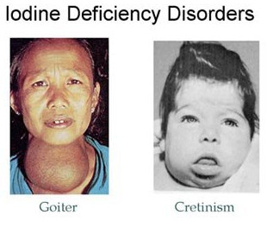
Thyroid gland diseases
Hypofunction of Thyroid
Cretinism
Myxedema
Hashimoto’s thyroiditis
Iodine deficiency (simple goiter)
Idiopathic hypothyroidism
Notes:
Hypothyroidism results in a slow metabolism due to a decrease in thyroid function
Cretinism can cause dwarfism and mental retardation in children

Slide 4
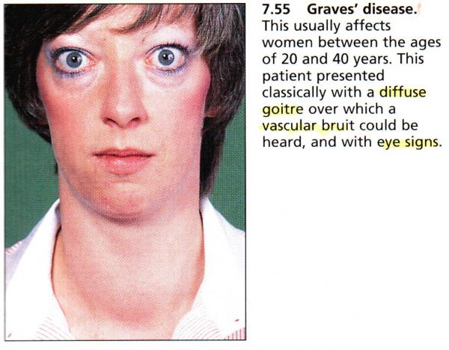
Thyroid Gland diseases
Hyperfunction of Thyroid
Hyperthyroidism
Thyrotoxicosis
Graves’ disease
Toxic nodular hyperplasia
Toxic adenoma, thyroid tumors
Notes:
1. Overproduction of thyroid hormone causing and increased metabolism

Slide 5
Adrenal gland diseases
Cushing's syndrome
Characterized by excessive circulating cortisol levels
Addison’s Disease
Partial or complete failure of adrenocortical function
Notes:
Cushing’s syndrome results form chronic steroid therapy
Addison’s disease is caused by Hypoadrenalism

Slide 6
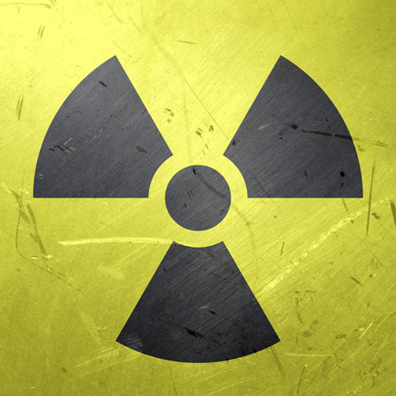
Treatment options
Thyroid Disorders
Medical/surgical intervention includes:
Levothyroxine (Synthroid, Levothroid)
Exogenous thyroid hormones for treatment of hypothyroidism
Radioactive Iodine (131I) for treatment of hyperthyroidism
Thyroidectomy
Antithyroid drugs
PTU and Tapazole
Notes:
Treatments for hyperthyroidism usually result in hypothyroidism
Antithyroid drugs are used in patients who cannot tolerate surgery or treatment with radioactive iodine
Dental implications for patients using thyroid gland agents include caution with epinepherine

Slide 7
Treatment options
Adrenal Disorders
Cushing’s Syndrome
Surgical removal or radiation of tumor (if indicated)
Drug therapy
Addison’s Disease
Hormone replacement therapy
Steroid supplementation may be necessary
Notes:
Tx depends on the cause of the over secretion of cortisol
Drug therapy to suppress secretions can be used separately or as an adjunct to radiation

Slide 8
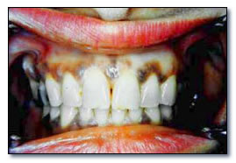
Oral manifestations
Addison’s Disease
Notes:
1. Diffuse pigmentation of skin and oral mucosa typically occur in Addison’s disease.

Slide 9
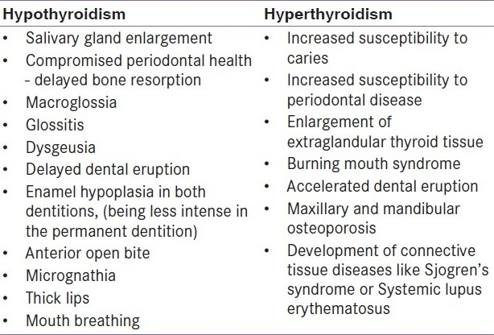
From: Indian J Endocrinol Metab. 2011 July; 15(Suppl2): S113–S116. doi: 10.4103/2230-8210.83343
Notes:
1. Common oral manifestations of patients with Thyroid Gland Disorders

Slide 10
Potential dental concerns
Cushing’s Syndrome
Double steroid dose
Delayed healing
Increased risk for infection
Hyperpararthyroidism
Increased bone loss
Hyperthyroidism
No epinepherine
Hypothyroidism
Delayed eruption of teeth
Malocclusion
Thick lips with protruding tongue
Notes:
A double steroid dose is required the day after surgery, for routine dental procedures there is usually no change in dosage
Delayed healing and increased risk for infection due to diminished immune response
Increased bone loss due to increased release of parathyroid hormone which leaches calcium from bone
Chronic oral infections can lead to a thyroid crisis in the patient with Hyperthyroidism.

Slide 11
Patient education
Patients with Hypothyroidism
Dysgeusia
Delayed eruption
Delayed wound healing
Susceptible to cardiovascular disease
Xerostomia
Patients with Hyperthyroidism
Increased risk of caries
Increased risk of periodontal disease
Increased risk for Graves disease
Anorexia
Xerostomia
Notes:
1. Our responsibility is to inform patients with hypothyroidism that they might experience
More susceptible to cardiovascular disease from arteriosclerosis and elevated LDL.
Younger patients are at risk for Graves disease
Patients older than 70 are at risk for anorexia
Could experience dry mouth from medications

Slide 12
Oral hygiene instruction
Radioactive Iodine
Xerostomia
Dysgeusia
Bass Method 2x a day
Soft Toothbrush
Toothpaste according to patient’s need
Floss C-Shaped 1-2x day
Antimicrobial rinse 1-2x day
Biotene
Notes:
1. Side effects of radioactive iodine include xerostomia and dysgeusia. Encourage patients to use sugarless gum, take frequent sips of water, eat moist foods, use Biotene, and have excellent OH. Dietary zinc can be incorporated in order to help with alteration in taste.

Slide 13
Nutritional counseling
Hypothyroidism
Avoid iodine depleting pesticides and soy
Avoid chlorine and fluoride
Eat iodine rich foods
Avoid certain raw vegetables
Adrenal Disorder
Inclusions
Exclusions
Key Nutrients
Iodine
Vitamin D
Vitamin B12
Notes:
Organic foods do not contain pesticides which are known to interfere with iodine absorption according to the Canadian School of Natural Nutrition
According to Prescription for nutritional healing by Phyllis Balch, chlorine and fluoride interfere with the thyroid’s ability to produce iodine containing hormones, leading to hypothyroidism.
Foods with a rich source of iodine include iodized sea salt, seafood, kelp, seaweed and other sea vegetables
Avoid raw brassica vegetables like cauliflower, broccoli, cabbage, turnips, brussel sprouts, and rutabagas. These are considered “goitrogenic” which suppress the thyroid when eaten raw.
Inclusions-fresh fruits and leafy green vegetables, deep-water ocean fish and wheat germ. Garlic and shiitake mushrooms are a potent immune system stimulant
Exclusions- white flour, sugar, red meat, pork and ham. Fried/processed foods, alcohol, caffeine and soft drinks because these foods cause a strain on the adrenal glands.
Key Nutrients- Iodine is a vital nutrient in the body and essential to thyroid function; thyroid hormones are comprised of iodine. Iodine deficiency has been considered rare in the United States largely due to the widespread use of iodized salt. This, along with fish, dairy, and grains, is a major source of iodine in the standard American diet.
Hyperthyroidism, particularly Graves’ disease, is known to cause bone loss, which is compounded by the vitamin D deficiency commonly found in people with hyperthyroidism.
Food sources of B12 include salmon, organ meats such as liver, muscle meat, and dairy. Severe B12 deficiency can be irreversible, so it’s important for dietitians to suggest clients with thyroid disease have their levels tested.
The isoflavones in soy can lower thyroid hormone synthesis, but numerous studies have found that consuming soy doesn’t cause hypothyroidism in people with adequate iodine stores

Slide 14
references
Frazier, M., & Drzymkowski, J., Essentials of Human Diseases and Conditions. Saunders, 4th Ed., 2009.
Haveles, E., Applied Pharmacology for the Dental Hygienist. Mosby, 6th Ed., 2010.
http://www.thyroid.org/patient-thyroid-information/ata-patient-education-web-brochures/
http://www.dentalcare.com/en-US/dental-education/continuing-education/ce110
http://www.livestrong.com/article/336014-nutritional-therapy-for-hypothyroid/
http://www.livestrong.com/article/462310-natural-diet-for-adrenal-disorder/
http://www.ncbi.nlm.nih.gov/pmc/articles/PMC3169868/

